Slide 1
The Field of Data Science
Artificial Intelligence
Shahriar’s Analytical Academy

Slide 2
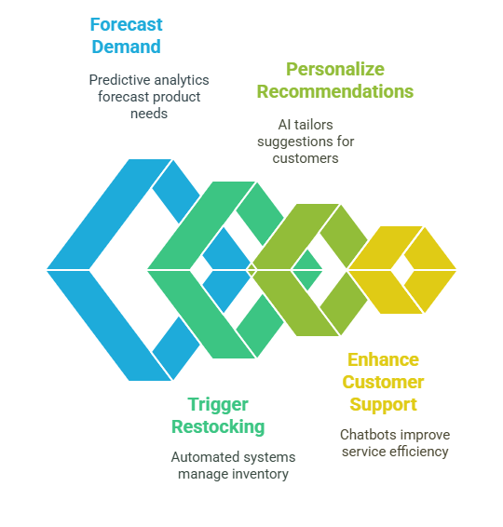
Definition and Example
Artificial Intelligence (AI) refers to the simulation of human intelligence in machines that are programmed to think and learn like humans.
It involves creating algorithms that enable computers to perform tasks that typically require human intelligence, such as visual perception, speech recognition, decision-making, and language translation.
Notes:
Artificial Intelligence (AI) is the simulation of human intelligence in machines that are programmed to think and learn like humans. AI involves creating algorithms that enable computers to perform tasks such as visual perception, speech recognition, decision-making, and language translation—tasks that typically require human intelligence. With AI, machines can analyze data, recognize patterns, make decisions, and improve their performance over time.
Example Scenario (Company Use):
Scenario: E-commerce Company
A large e-commerce company, such as Amazon, leverages AI to enhance its supply chain and inventory management. AI algorithms analyze historical sales data to forecast demand for various products, ensuring products are stocked in the right amounts at the right times. AI systems also automate the restocking process based on these predictions and personalize customer experiences by recommending products based on browsing history and preferences. Additionally, AI-powered chatbots handle customer inquiries, providing efficient, responsive support around the clock.

Slide 3
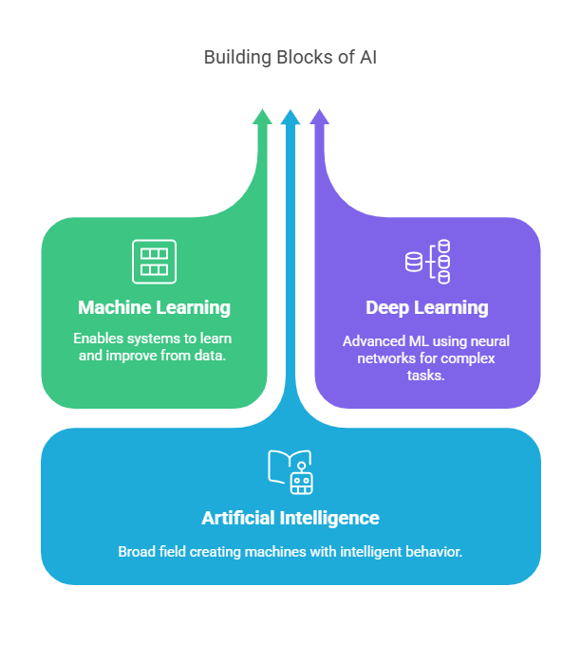
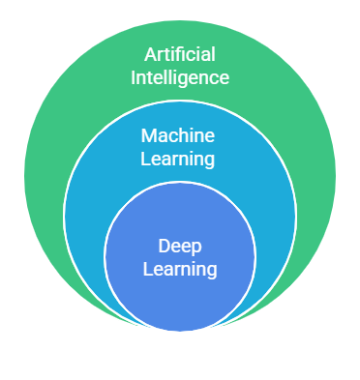
ML vs DL vs AI
Notes:
Artificial Intelligence (AI) is the broadest concept, encompassing a wide range of intelligent behaviors and techniques. It aims to replicate human-like intelligence in machines and includes tasks like problem-solving, decision-making, and pattern recognition. Machine Learning (ML) is a subset of AI, focusing specifically on enabling machines to learn from data without being explicitly programmed. It allows systems to identify patterns and make predictions based on historical data. Deep Learning (DL) is a specialized subset of ML, using deep neural networks to handle more complex tasks such as image recognition and speech processing. DL excels in solving problems that require vast datasets and significant computational power.
AI covers both simple and complex tasks, from rule-based decision-making to advanced reasoning and planning. ML, on the other hand, is typically used for tasks like classification, regression, and prediction, where the system learns from data and improves over time. Deep Learning is reserved for more intricate tasks that require large amounts of data and advanced processing, such as autonomous vehicles and natural language understanding. While AI is the overarching field, ML focuses on data-driven learning, and DL targets highly complex, data-intensive challenges.
In conclusion, while AI is the broad field that seeks to replicate human-like intelligence in machines, ML is a subset of AI that enables machines to learn from data, and DL is a more advanced subset of ML, focusing on neural networks and complex patterns. While AI covers a range of techniques, ML focuses specifically on data-driven learning, and DL uses deep neural networks for tasks requiring vast amounts of data and computational power.

Slide 4
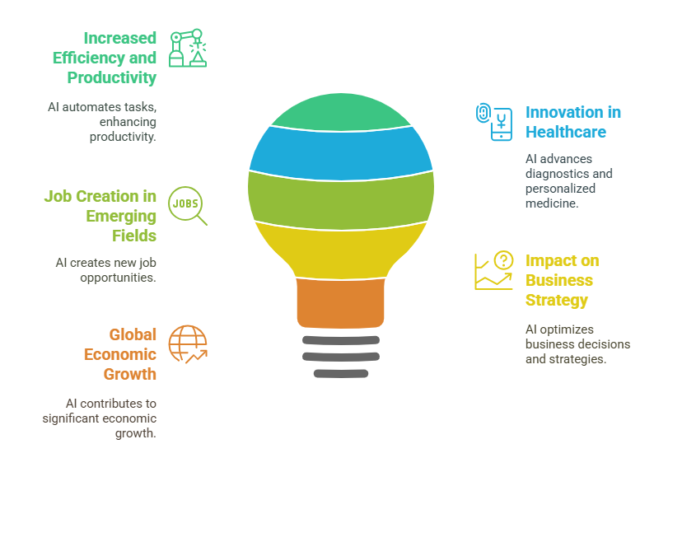
Importance of Artificial Intelligence
Notes:
Increased Efficiency and Productivity:
AI can automate repetitive and routine tasks, allowing businesses and individuals to focus on more complex and creative endeavors. For example, in manufacturing, AI-powered robots can work continuously without fatigue, significantly improving production rates. This automation not only boosts efficiency but also leads to cost savings and improved output quality.
Innovation in Healthcare:
AI holds the potential to transform healthcare by improving diagnostics, developing personalized medicine, and accelerating drug discovery. AI can analyze vast amounts of medical data to predict diseases, suggest personalized treatment plans, and even help in early disease detection, leading to better patient outcomes. AI-driven innovations will help make healthcare more accessible and efficient.
Job Creation in Emerging Fields:
While AI may displace some jobs, it will also create new career opportunities in fields like AI development, data science, machine learning engineering, and cybersecurity. As AI technologies evolve, the demand for skilled professionals in these areas will continue to rise. The key will be upskilling workers and ensuring they are prepared for the new roles that emerge alongside technological advancements.
Impact on Business Strategy:
AI will enable businesses to make data-driven decisions, optimize operations, and enhance customer experiences. By analyzing vast amounts of data, AI can help businesses predict trends, streamline supply chains, and personalize marketing efforts. This leads to more effective business strategies and a competitive advantage in the market.
Global Economic Growth:
Countries investing in AI technologies are expected to see significant economic growth. AI has the potential to contribute trillions of dollars to global GDP by improving productivity, creating new industries, and fostering innovation. As AI becomes integral to various sectors, its economic impact will be transformative on a global scale.

Slide 5
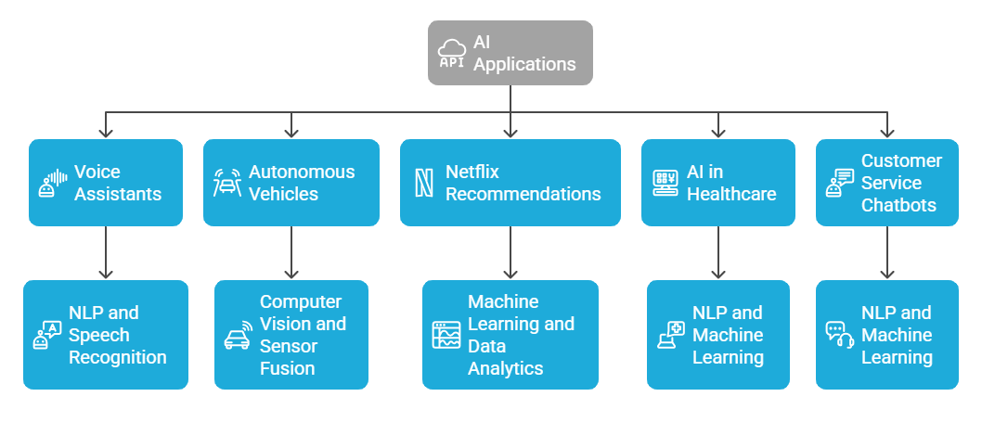
Real – life examples of AI Apps
Notes:
Google Assistant/Siri/Alexa:
AI-powered voice assistants like Google Assistant, Siri, and Alexa help users perform tasks such as setting reminders, playing music, checking the weather, and answering questions by processing natural language. These assistants use Natural Language Processing (NLP) and Speech Recognition technologies to understand and respond to user commands in real-time, making them indispensable in daily life.
Autonomous Vehicles (e.g., Tesla):
Self-driving cars, such as those from Tesla, use AI to interpret data from cameras, sensors, and radar to navigate and make decisions without human input. The technology relies on deep learning, computer vision, and sensor fusion to process the information and drive the vehicle safely. AI enables autonomous vehicles to recognize objects, pedestrians, and road signs, making them safer and more efficient than human-driven cars.
Netflix Recommendations:
AI algorithms power Netflix’s recommendation system, analyzing a user’s viewing habits to suggest shows and movies tailored to their preferences. The system uses machine learning and data analytics to continually refine its recommendations based on users' past interactions, ensuring a personalized and engaging viewing experience.
AI in Healthcare – IBM Watson Health:
IBM Watson Health uses AI to analyze medical data and assist doctors in making more accurate diagnoses and developing personalized treatment plans. By leveraging Natural Language Processing and Machine Learning, Watson can sift through vast amounts of unstructured medical data to provide insights that help healthcare professionals deliver better patient care.
Chatbots for Customer Service (e.g., LiveChat, Zendesk):
AI-powered chatbots, like those used in LiveChat and Zendesk, are revolutionizing customer service by providing quick responses to common inquiries and assisting with troubleshooting. These chatbots use NLP and machine learning to understand and respond to customer questions, improving efficiency and reducing the need for human intervention.

Slide 6
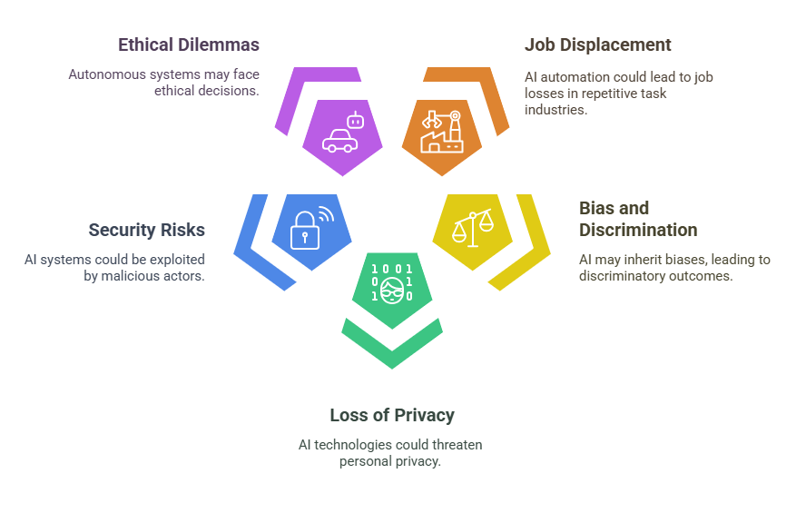
Potential risks of AI
Notes:
Job Displacement:
AI automation could lead to the displacement of jobs, particularly in industries where repetitive tasks are common, such as manufacturing and customer service. While some roles may become obsolete, new opportunities will arise in fields like AI development, data science, and cybersecurity. Workers will need to upskill and adapt to the changing job landscape.
Bias and Discrimination:
AI systems can inherit biases from the data they are trained on, leading to unfair or discriminatory outcomes in areas such as hiring, lending, and law enforcement. To mitigate this risk, it’s essential to use diverse and representative datasets and conduct regular audits of AI systems to ensure they operate fairly and without bias.
Loss of Privacy:
AI technologies, particularly those used in facial recognition and data mining, raise concerns about the loss of personal privacy. AI systems can track individuals and build profiles without their consent, creating potential risks for misuse of personal data. Stricter privacy laws and ethical guidelines for AI use are necessary to protect individuals' privacy.
Security Risks:
AI systems could be vulnerable to exploitation by malicious actors, who could use AI to breach security systems or create deepfakes. To address these concerns, robust cybersecurity frameworks and AI defense mechanisms must be developed to safeguard against these threats and protect sensitive data.
Ethical Dilemmas in Autonomous Systems:
Autonomous systems, such as self-driving cars, may face complex ethical decisions, like how to prioritize lives in an accident scenario. To ensure ethical decision-making, AI ethics frameworks need to be developed, and human oversight should be maintained to guide the decisions made by autonomous systems in critical situations.

Slide 7
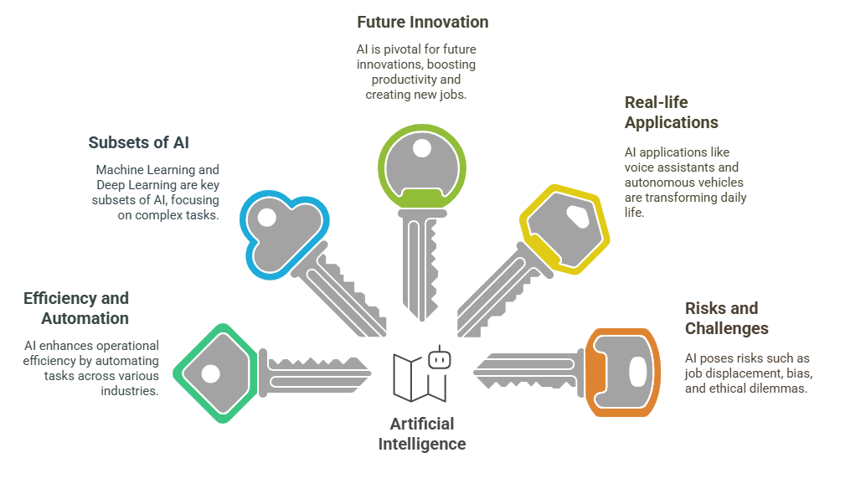
5 Key Learning Points of this Lesson
Notes:
AI is a transformative technology that allows machines to perform tasks traditionally done by humans, such as problem-solving, decision-making, and pattern recognition. This capability significantly boosts efficiency in various sectors, from healthcare to manufacturing, by automating processes, reducing human error, and increasing productivity.
While AI is the broad field, Machine Learning (ML) focuses on teaching machines to learn from data without explicit programming. Deep Learning (DL), a more advanced subset of ML, utilizes multi-layered neural networks to tackle complex tasks like image recognition and autonomous driving. ML and DL both contribute to the overall success of AI by providing specialized methods for handling data-driven challenges.
AI is not only a powerful tool for innovation but also a driver of economic growth. As AI technologies advance, they enable new products and services that were once unimaginable. Moreover, AI is expected to create new career opportunities in fields like AI development, data science, and machine learning engineering, even as it transforms existing jobs and industries. AI has already begun reshaping our everyday experiences through applications like Google Assistant, Siri, and Alexa, which help with tasks using voice recognition. Additionally, autonomous vehicles like self-driving cars, and AI-driven recommendation systems on platforms like Netflix and Amazon, are revolutionizing transportation, entertainment, and customer service industries. These innovations highlight the growing influence of AI in our daily lives. Despite its benefits, AI poses challenges such as job displacement, where automation could replace certain roles in sectors like manufacturing and customer service. AI systems can also inherit biases from the data they are trained on, leading to discrimination.

Slide 8
Thank You!
Shahriar’s Analytical Academy

